Slide 1
Mlsa Full stack internship name : Yash Sangwan roll.no. : 2300290120287 year:2nd

Slide 2
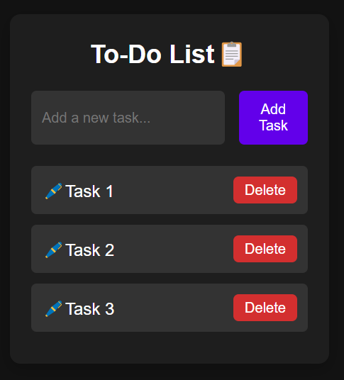
Project 1 : todo list (easy)

Slide 3
Technology used:
HTML
CSS
Javascript

Slide 4
Features:
Add a task
Delete a task
Mark a task as completed
Retrieve tasks from localstorage
Save tasks to localstorage

Slide 5
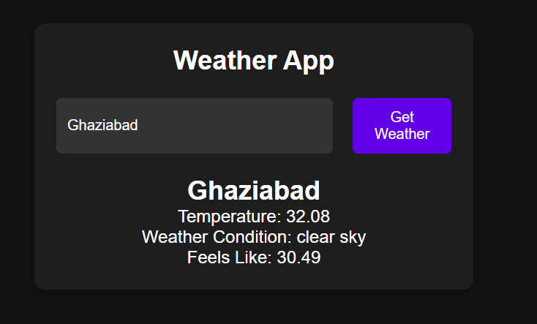
Project 1 :Weather app (intermediate)

Slide 6
Technology used:
HTML
CSS
Javascript

Slide 7
Features:
Fetch Data by City name
Show clear error if city name not found
Tell the current temperature of the city
Tell weather Condition
Tell Feels like temperature

Slide 8
Thank you

